Slide 1

DEFENSE ROBOTICS · CONFIDENTIAL
THAR
Tactical Quadruped Ground Robot
Precision. Power. Preservation of Life.
INVESTOR & PARTNERSHIP PITCH DECK
Version 2.0 · July 2026 · Engineering Brief
01 / 11

Slide 2
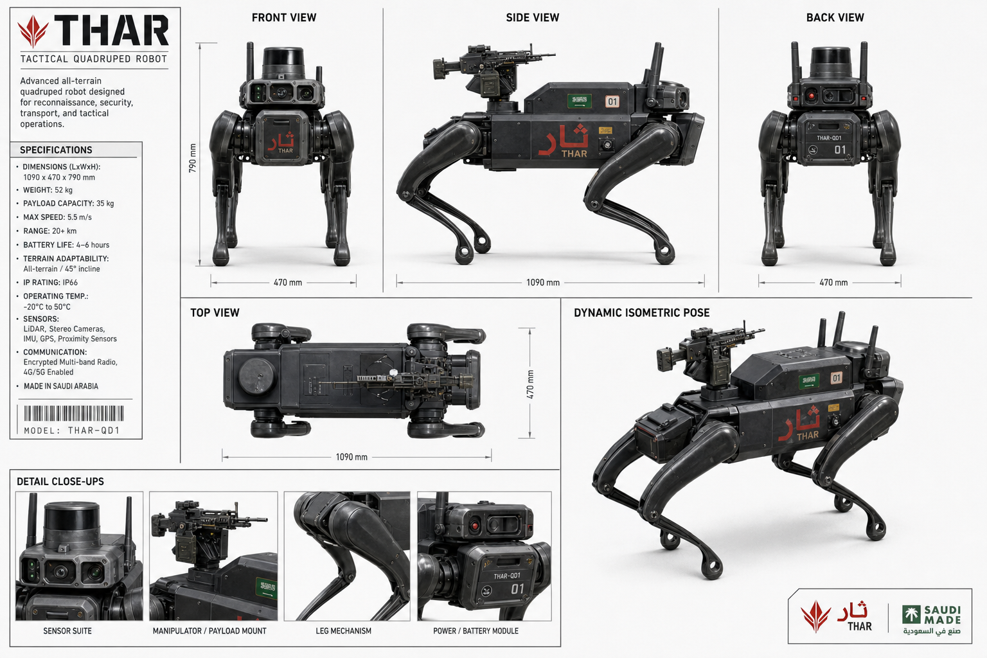
01 · MISSION CONTEXT
OPERATIONAL PARADIGM
▸ Harsh Terrains: Mountains, soft sand, and extreme heat defeat wheeled/tracked UGVs
▸ High-Risk Missions: Border patrol and recon expose soldiers to lethal threat
▸ THAR Solution: Agile AI-driven quadruped built for Saudi extreme environments
▸ Doctrine: Expendable yet lethal — machines take the risk, not soldiers
Core mission: project autonomous capability into hostile zones while shielding human life.
THAR · TACTICAL QUADRUPED · CONFIDENTIAL
02 / 11

Slide 3
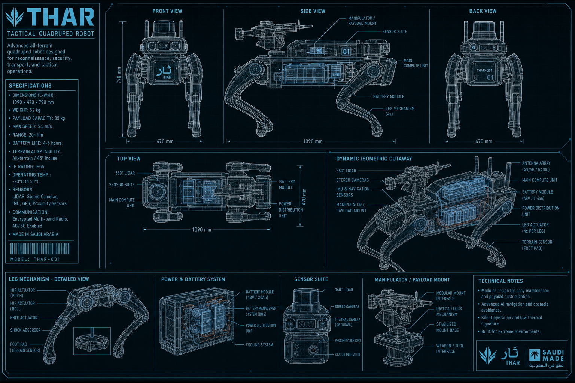
02 · STRUCTURE
ENGINEERING & MATERIALS
▸ Chassis: Aerospace Aluminum 7075-T6 + CFRP / Kevlar shielding
▸ Dimensions: 1.2 m L · 0.8 m W · 0.9 m H
▸ Mass & Payload: ~50 kg base · up to 20 kg tactical payload
▸ Thermal: Active liquid-cooling for continuous 50°C+ operation
▸ Sealing: IP67+ labyrinth joints against silica dust ingress
THAR · TACTICAL QUADRUPED · CONFIDENTIAL
03 / 11

Slide 4
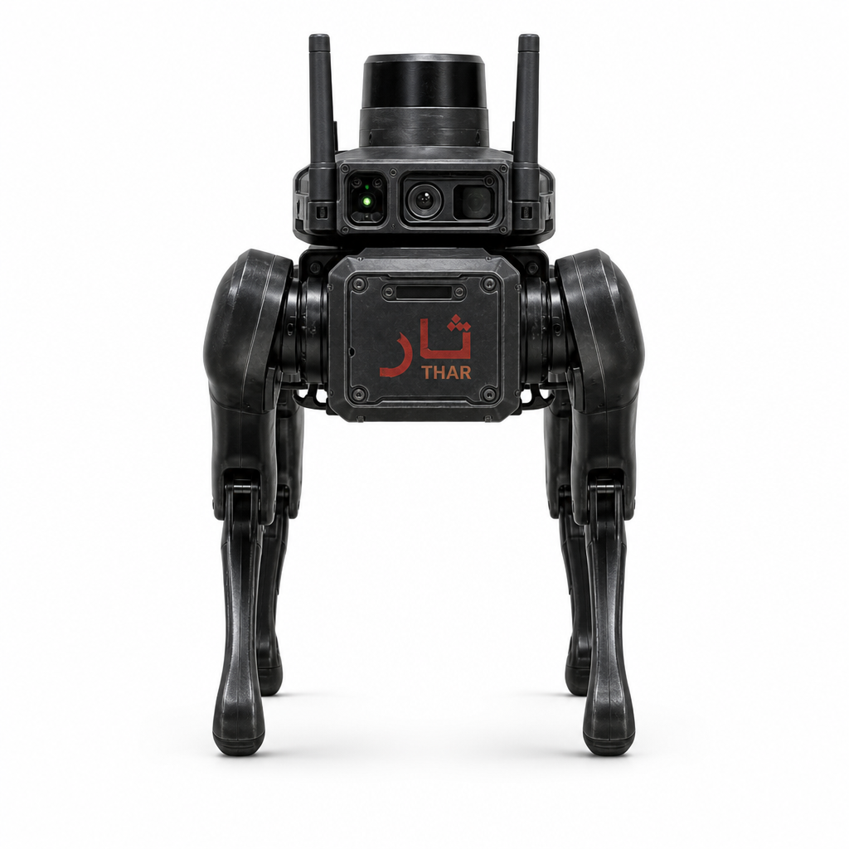
03 · PERCEPTION
MULTI-MODAL SENSOR FUSION
▸ 3D LiDAR: Solid-state real-time mapping and SLAM
▸ Thermal Imaging: FLIR Boson long-range heat signatures
▸ RGB-D Vision: HDR stereo for close-quarters avoidance
▸ Optics: Sapphire lenses against sand abrasion
▸ Mission Profile: Zero-visibility sandstorm and night operations
THAR · TACTICAL QUADRUPED · CONFIDENTIAL
04 / 11

Slide 5
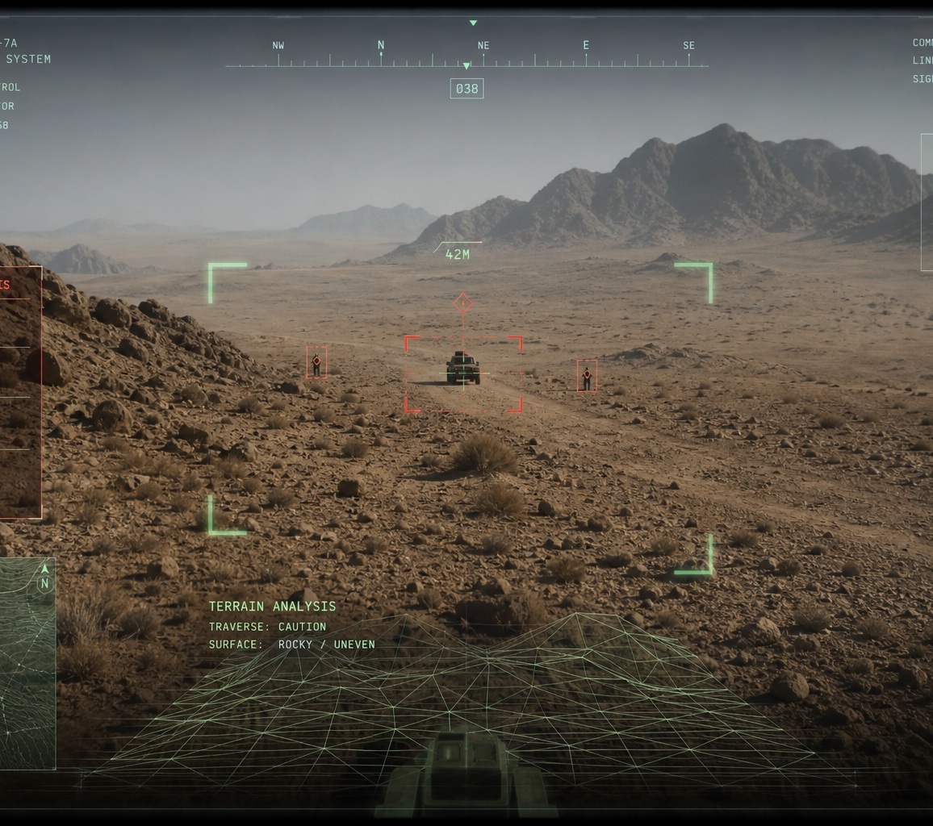
04 · AUTONOMY
EDGE COMPUTING & AI
▸ Compute: NVIDIA Jetson Orin NX up to 100 TOPS
▸ OS Stack: Hardened Linux with ROS 2
▸ Autonomy: Waypoints, dynamic avoidance, threat classification
▸ Tactical HUD: Encrypted FPV with AI brackets & telemetry
▸ Sovereignty: No cloud dependency for critical survival loops
Zero latency. Total sovereignty including GPS-denied and jammed environments.
THAR · TACTICAL QUADRUPED · CONFIDENTIAL
05 / 11

Slide 6
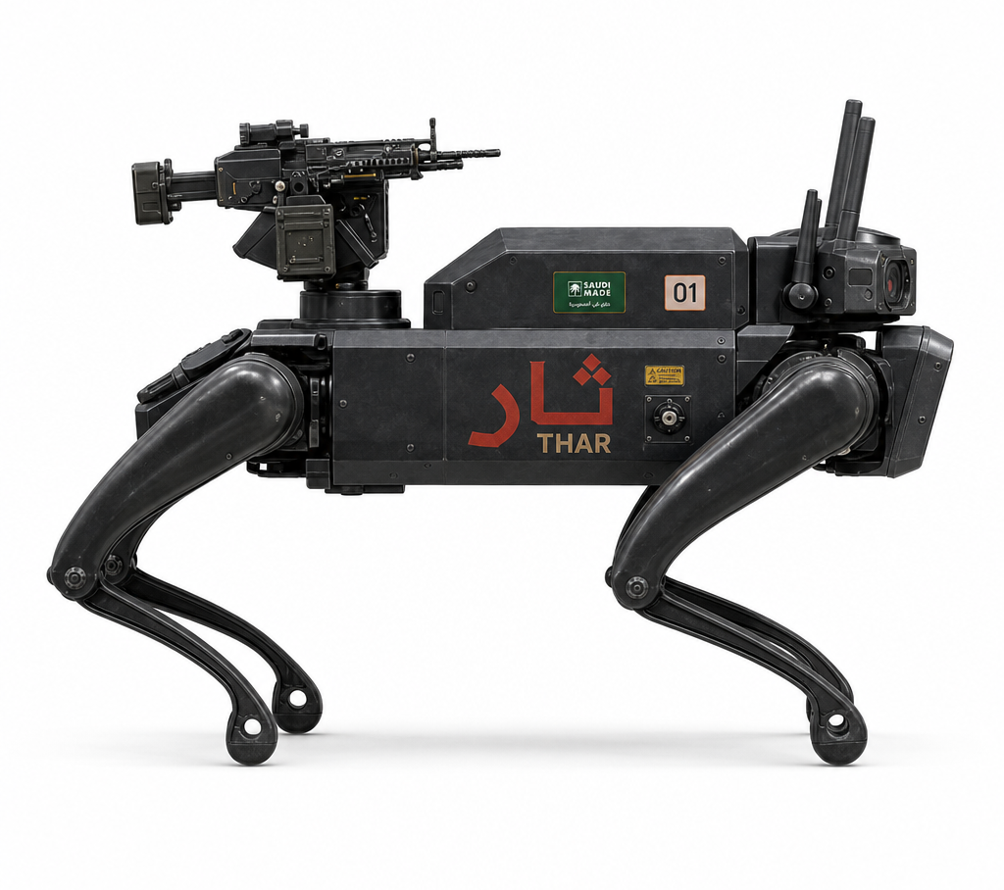
05 · MOBILITY
KINEMATICS & ACTUATION
▸ Quasi-Direct Drive: 12 DoF high-torque BLDC actuators
▸ Proprioception: Motors feel terrain via current spikes
▸ Reflexes: Micro-second adjustments without optical-only sensing
▸ Agility: Steep inclines, rubble traversal, and fall recovery
▸ Balance: Low center of gravity for high-speed stability
THAR · TACTICAL QUADRUPED · CONFIDENTIAL
06 / 11

Slide 7
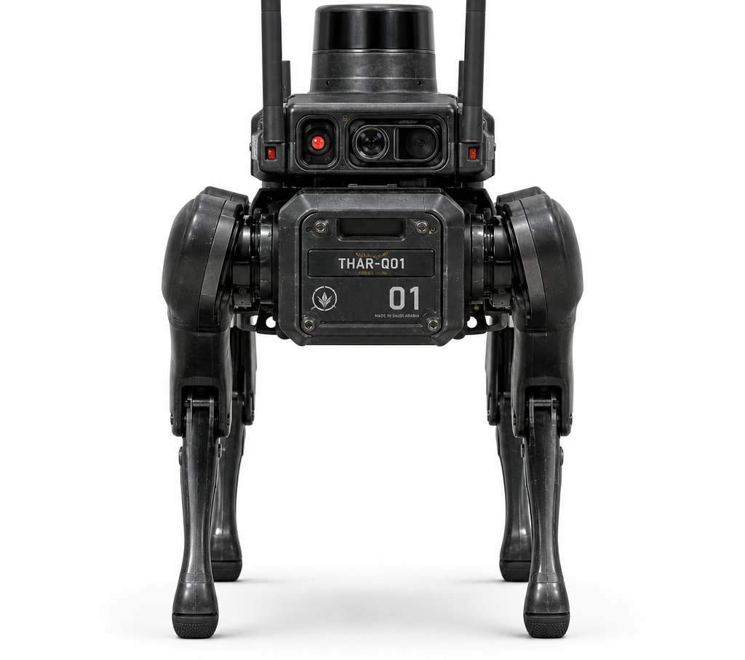
06 · MISSION KITS
MODULAR PAYLOADS & POWER
▸ Power: 60V high-discharge Li-ion pack
▸ Hot-Swap: Battery exchange in under 60 seconds
▸ Endurance: Up to 3 hours mixed-terrain operation
▸ Rails: NATO Picatinny for ISR, logistics, and LRWS
▸ BMS: Dynamic power routing by mission priority
THAR · TACTICAL QUADRUPED · CONFIDENTIAL
07 / 11

Slide 8
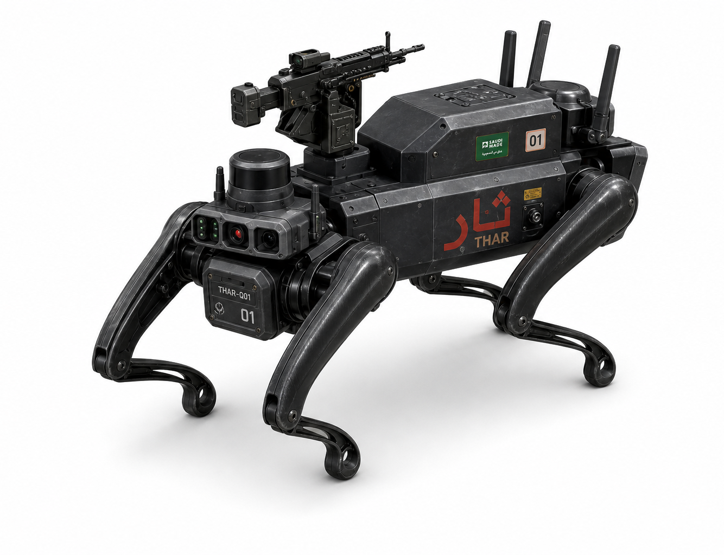
07 · PRODUCTION INTENT
ADVANCED 3D VISUALIZATION
Cinematic and isometric renders highlighting subsystems, thermal vents, and payload rails.
FIG · ISOMETRIC PLATFORM
FIG · DYNAMIC POSE SHEET
THAR · TACTICAL QUADRUPED · CONFIDENTIAL
08 / 11

Slide 9
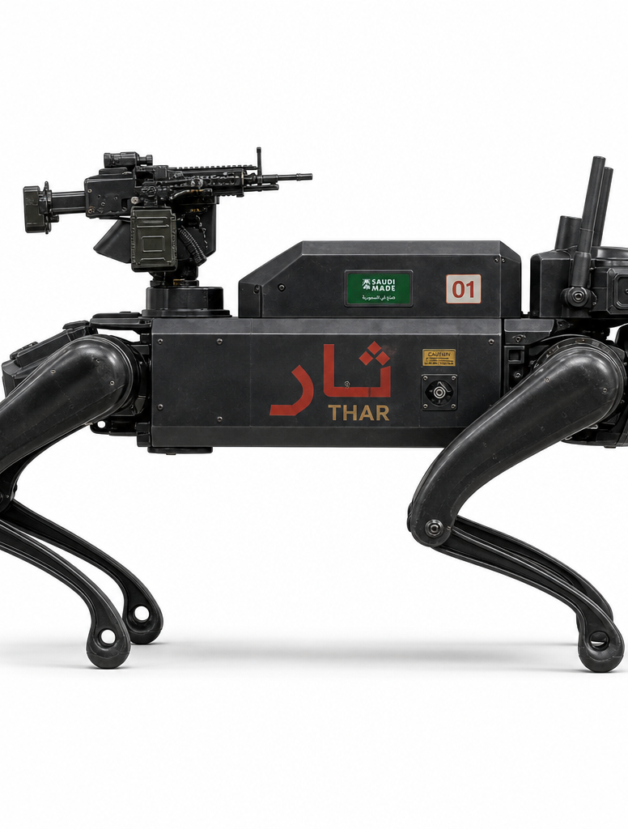
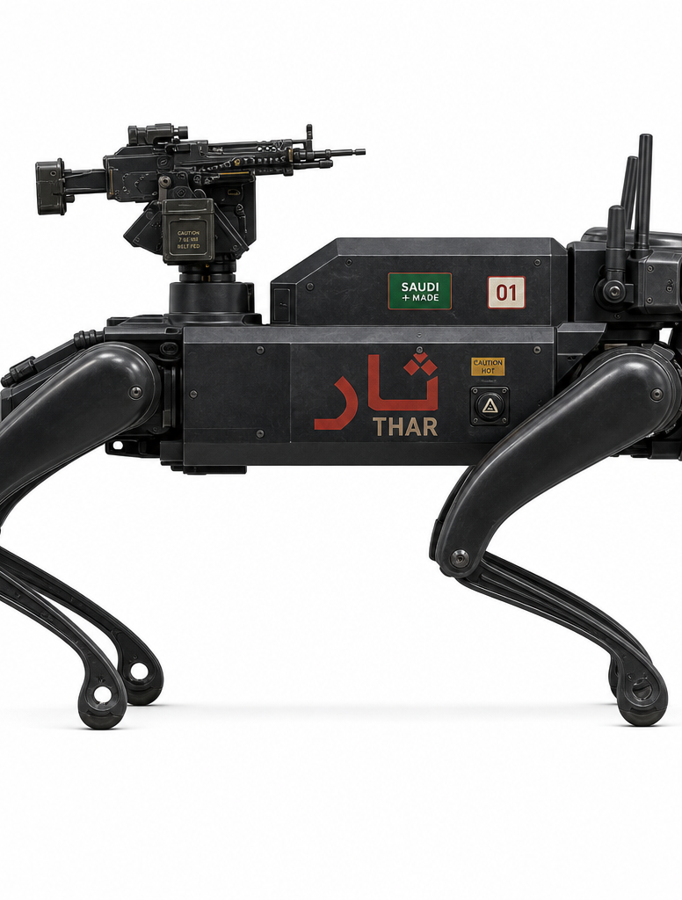
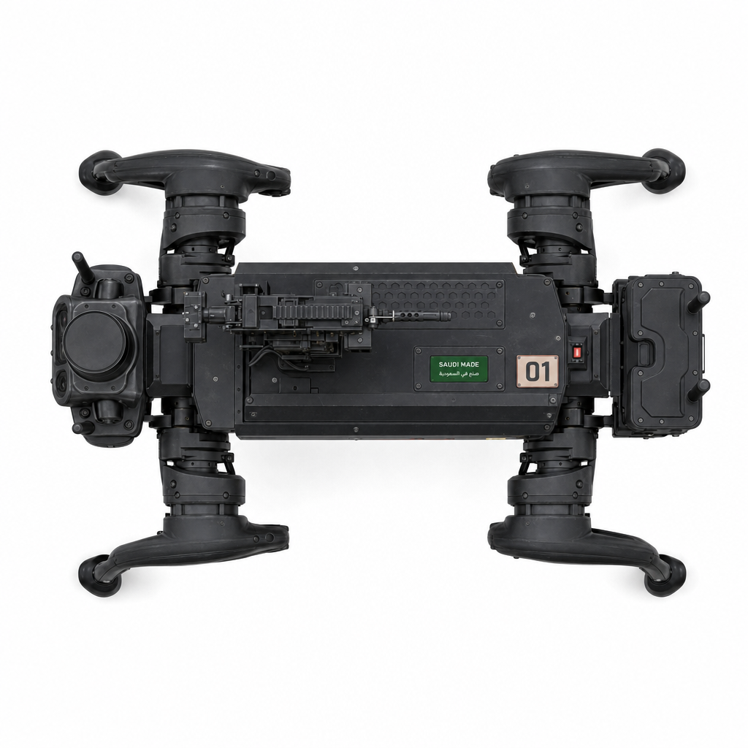
08 · MANUFACTURING VIEWS
ORTHOGRAPHIC PROJECTIONS
Precision engineering from every angle — rapid manufacturing, weight distribution, maintenance access.
LEFT
RIGHT
TOP
Head
THAR · TACTICAL QUADRUPED · CONFIDENTIAL
09 / 11

Slide 10
09 · GO-TO-FIELD
DEPLOYMENT ROADMAP
PHASE 1
PHASE 2
PHASE 3
CURRENT
Q3 2026
2027
Prototype design, simulation, and full engineering specifications.
Manufacture 3–5 physical prototypes for Saudi terrain field testing.
Advanced military payload integration and active deployment trials.
Objective: Secure strategic partnerships for Phase 2 manufacturing and field validation.
THAR · TACTICAL QUADRUPED · CONFIDENTIAL
10 / 11

Slide 11
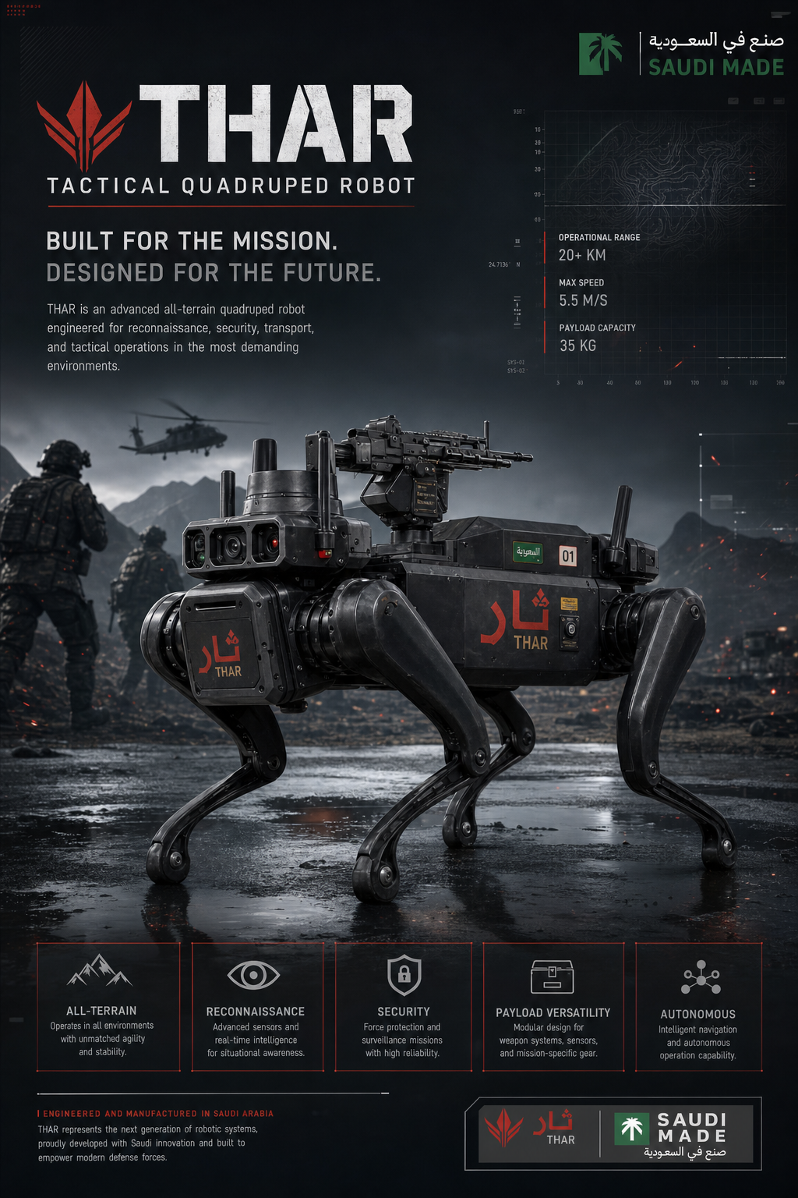
THAR
The Future of
Ground Operations
Thank You.
Ready for Technical Deep-Dive.
By MOHMMAD ABYAH
CONFIDENTIAL · THAR DEFENSE ROBOTICS
11 / 11

